Slide 1
Data Literacy Series: Training #5 Graduation Rate Data Chronic Absenteeism in NJSMART Data Dashboards
Division of Field Support and Services Office of Comprehensive Support
June 5, 2024

Slide 2
Please Review
The New Jersey Department of Education (NJDOE) may record audio, visuals, participants, and other information sent, verbalized, or utilized during business-related meetings. By joining this meeting, you automatically consent to such recordings. Any participant who prefers to participate via audio only should keep their camera disabled so only their audio will be captured.
PLEASE NOTE: Under certain circumstances, audio/video recording may be restricted. Recording will be in accordance with all applicable federal, state, and local statutes, regulations, or ordinances. As we endeavor to offer a safe, collegial, and inclusive space for collaboration we respectfully request that no participant or third-party entity, on your behalf, record or transcribe today’s conversation. The NJDOE can provide a transcript of these proceedings, upon request. Screenshots, photography, or other copying of chat exchanges is prohibited unless permission is granted by the NJDOE and advance notice is provided to all participants.

Slide 3
Welcome

Slide 4
Graduate Rate Panel Discussion Central High School (Newark) Mastery Schools (Camden) Passaic Preparatory Academy (Passaic) Thomas Edison Career & Technical (Elizabeth)

Slide 5
4-Year Graduation Rates – 2020-23
County Name | District Name | School Name | 2020 | 2021 | 2022 | 2023 | Total Increases 2020 to 2023 | Overall Change 2020 to 2023
Passaic | Passaic City | Passaic Preparatory Academy | 77.4 | 70.7 | 90 | 93.9 | 2 | 16.5
Hudson | Bayonne | Bayonne Alternative HS | 33.3 | 29 | 35.6 | 47.4 | 2 | 14.1
Camden | Mastery Schools Of Camden Inc. | Mastery Schools Of Camden Inc. | 74.7 | 75.7 | 74.9 | 86.5 | 2 | 11.8
Charter | Great Oaks Legacy CS | Great Oaks Legacy CS | 81 | 93 | 95.4 | 92.4 | 2 | 11.4
Union | Elizabeth | Thomas Jefferson Arts Academy | 76.9 | 82.3 | 85.7 | 88.3 | 3 | 11.4
Essex | Newark | Central HS | 75.6 | 76.4 | 83.3 | 86.2 | 3 | 10.6
Passaic | Passaic City | Passaic HS No. 12 | 58.7 | 52.8 | 59.5 | 68.7 | 2 | 10
Union | Elizabeth | Thomas A. Edison | 76.2 | 77.3 | 81.6 | 86 | 3 | 9.8
Passaic | Paterson | John F. Kennedy HS | 80.4 | 83.6 | 92.1 | 90.1 | 2 | 9.7
Union | Elizabeth | Admiral William F. Halsey Jr. | 71 | 69.1 | 78.3 | 79.1 | 2 | 8.1

Slide 6
Key Questions/Topics for Panel
What have been the most helpful leading indicators to use for determining your graduation rate?
Do you have a process for screening incoming freshmen who may be at-risk of not graduating in four years? How so?
Do you tier supports for upperclassmen who may be at risk of not graduating in four years? How so?
What interventions have you found to be the most helpful in helping as many students as possible graduate on-time?
How do you work with your district in ensuring your graduation rate is optimal and accurate?

Slide 7
Additional Questions?

Slide 8
Break
We will take a five-minute stretch break.

Slide 9
Graduation Rate Data

Slide 10
Adjusted Cohort Methodology

Slide 11
Adjusted Cohort Graduation Rates
2011
New Jersey introduced the adjusted cohort graduation rate (ACGR) calculation in 2011 to align with federal requirements.
Prior to 2011, a traditional non-cohort-based graduation rate calculation was used that calculated the percentage of 12th graders that graduated each year.
All states are required to use the ACGR methodology so that rates can be compared across states.
However, each state has its own graduation requirements, which means that graduation rates across states may not be completely comparable.
Fewer than 10 states still have graduation assessment requirements in place.
Some states offer multiple types of diplomas.
Some states award a state-defined alternate diploma to students with the most significant cognitive disabilities.

Slide 12
Graduation Cohorts
A cohort is a group of students who entered 9th grade during the same school year.
Entering 2020-2021 9th graders
Assigned based on expected four-year graduation
Cohort 2024

Slide 13
Adjusted Cohorts
During high school, a school or district’s cohort is adjusted each year.
Students who transfer in
Initial Cohort
Add
Adjusted Cohort
Students who transfer out
Subtract

Slide 14
Adjusted Cohorts Example
2021-2022
2020-2021
5 students move on to grade 10
1 student is retained in grade 9
1 student drops out of high school
2 students transfer to another district
Change to new district’s cohort
Initial Cohort = 10 students
1 student moves out of state
Excluded from cohort
2021-2022 Adjusted Cohort = 9 students
2 new students move to the district

Slide 15
Students Entering after 9th Grade
If a student enters a New Jersey public high school after 9th grade, they will be added to the cohort that corresponds to when they would have entered 9th grade.
Student from another country enrolls as 11th grader in 2022-2023 (first time enrolling in a New Jersey high school).
Assigned to Cohort 2024 (assume enrolled in 9th grade in 2020-2021)
Student initially attends New Jersey high school as 9th grader in 2019-2020 and then moves out of country.
Student returns to New Jersey high school as 11th grader in 2022-2023.
Assigned to Cohort 2023 (records show student entered 9th grade in 2019-2020)

Slide 16
Removing Students From Cohorts
The U.S. Department of Education has very strict guidelines about when students can be removed from a graduation cohort.
A student can only be removed from a cohort if the LEA has written confirmation of the following situations:
Adjusted Cohort
Student transfers and enrolls in another high school or educational program that awards regular or state-defined alternate diplomas
Student leaves a public high school to be homeschooled
Student emigrates to another country
Unverified Transfers
Death of a student

Slide 17
Changing Cohorts
A student’s cohort year cannot be changed once it has been established. This includes:
Students who graduate early
Students who are retained in high school
Students with disabilities who are eligible to remain enrolled until age 21
Students who drop out of school and later re-enroll in high school
Students who drop out of school and later re-enroll in high school
Students transferring between schools or districts
Students entering high school after grade 9
Students who drop out of school and later re-enroll in high school

Slide 18
Calculating Graduation Rates

Slide 19
Graduates
In New Jersey, a student is considered a graduate when they receive a state-endorsed diploma.
This includes students with disabilities whose IEPs include modifications or exemptions to the graduation requirements.
Students who earn a state-issued diploma by passing a high school equivalency assessment are not counted as graduates.

Slide 20
Graduates – Federal Requirements
For federal purposes, a student is considered a graduate if they have earned a “regular high school diploma” that is fully aligned with the State’s standards.
This means that students must earn a state-endorsed diploma and have met the state’s graduation assessment, course, and local attendance requirements.
Students with disabilities who earn a state-endorsed diploma but did not meet some or all graduation requirements because of a modification or exemption in their IEPs cannot be counted as a graduate for federal purposes.

Slide 21
State and Federal Calculations
Starting in 2021, the New Jersey Department of Education (NJDOE) began calculating two versions of the adjusted cohort graduation rate.
Calculation Version
Who is Included in Graduate Count
How is it Used?
State Version
All students earning a state-endorsed diploma
State reporting and NJQSAC
All students earning a state-endorsed diploma who have met graduation assessment, course, and attendance requirements.
Does not include students with disabilities who did not meet some or all requirements because of a modification or exemption in their IEPs.
Federal reporting and ESSA Accountability
Federal Version

Slide 22
Adjusted Cohort Graduation Rate
The adjusted cohort graduation rate measures the percentage of the students who entered ninth grade at the same time (i.e., in the same cohort) who graduate high school by a certain point in time.
Four-Year Adjusted Cohort Graduation Rate
Percentage of students in the adjusted cohort who graduate by the end of four years. This includes students who graduate in less than four years.
Five-Year Adjusted Cohort Graduation Rate
Percentage of students in the adjusted cohort who graduate by the end of five years. This includes students who graduate in four years or less.
Six-Year Adjusted Cohort Graduation Rate
Percentage of students in the adjusted cohort who graduate by the end of six years. This includes students who graduate in five years or less.

Slide 23
Adjusted Cohort Graduation Rate
The adjusted cohort graduation rate measures the percentage of the students who entered ninth grade at the same time (i.e., in the same cohort) who graduate high school by a certain point in time.
Four-Year Adjusted Cohort Graduation Rate
4-year graduates
Adjusted cohort at the end of 4 years
Five-Year Adjusted Cohort Graduation Rate
4-year + 5-year graduates
Adjusted cohort at the end of 5 years
Six-Year Adjusted Cohort Graduation Rate
4-year + 5-year + 6-year graduates
Adjusted cohort at the end of 6 years

Slide 24
Graduation Dates
Any student who graduates between September 1 and August 31 of a given school year will be counted in the graduation rate for that year.
Sep.
Oct.
Nov.
Dec.
Jan.
Feb.
Mar.
Apr.
May
Jun.
Jul.
Aug.
Early Graduates (September – May)
June Graduates
Summer Graduates

Slide 25
Four-Year Example
School A’s adjusted cohort for Cohort 2024 has 102 students as of August 31, 2024. (These are students who started 9th grade in 2020-2021)
95 students graduate by August 31, 2024
93 graduates have met all graduation requirements
4-year Graduation Rate (State Calculation)
95
93.1%
102
2 graduates are students with disabilities who did not meet state course requirements because of modifications or exemptions in their IEPs.
4-year Graduation Rate (Federal Calculation)
93
91.2%
102

Slide 26
Five-Year Example
During the 2024-2025 school year, School A’s adjusted cohort changes based on transfers in and transfers out.
2 students transfer in.
Added
5-year Adjusted Cohort
102 + 2 – 1
103
1 student transfers out.
Removed
2 students drop out.
Remain
3 more students graduate during the 2024-2025 school year.
5-year Graduation Rate (State Calculation)
95 + 3
95.1%
103
1 of the 2025 graduates does not meet the graduation assessment requirements, but meets alternate requirements specified in their IEP.
5-year Graduation Rate (Federal Calculation)
93 + 2
92.2%
103

Slide 27
Five-Year Compared to Four-Year
Five-year rates are typically higher than four-year rates. However, there are rare cases where the five-year may be lower than the four-year.
5 students transfer in.
Added
5-year Adjusted Cohort
102 + 5 – 1
106
1 student transfers out.
Removed
2 students drop out.
Remain
3 more students graduate during the 2024-2025 school year.
5-year Graduation Rate (State Calculation)
95 + 3
92.5%
106
1 of the 2025 graduates does not meet the graduation assessment requirements, but meets alternate requirements specified in their IEP.
Lower than the 4-year rate of 93.1%

Slide 28
State and Federal Accountability

Slide 29
Federal/ESSA Requirements
Federal Requirements
New Jersey
Report four-year adjusted cohort graduation rates to the U.S. Department of Education each year through EDFacts.
New Jersey included four-year and five-year adjusted cohort graduation rates in its 2017 ESSA State Plan.
New Jersey uses and reports the federal version of the four-year and five-year adjusted cohort graduation rates for ESSA and EDFacts.
Include four-year adjusted cohort graduation rates in their ESSA accountability system.
Align calculations with federal requirements for defining graduates.
ESSA accountability is based on overall school graduation rates and student group rates.
New Jersey will be proposing to amend the ESSA State plan to include six-year adjusted cohort rates, along with the four-year and five-year rates, in the future.
Optional: States may report/include extended year graduation rates, in addition to four-year.

Slide 30
ESSA Graduation Indicator
In the ESSA accountability system, 4-year and 5-year graduation rates are equally weighted. The weights are based on school configuration and inclusion of the Progress toward English language proficiency (ELP) indicator.
Indicator | HS (with ELP) | HS (no ELP) | Mixed (with ELP) | Mixed (no ELP)
ELA Proficiency | 15% | 17.5% | 10% | 12.5%
Math Proficiency | 15% | 17.5% | 10% | 12.5%
ELA Growth | n/a | n/a | 12.5% | 15%
Math Growth | n/a | n/a | 12.5% | 15%
4-Year Graduation Rate | 20% | 25% | 12.5% | 15%
5-Year Graduation Rate | 20% | 25% | 12.5% | 15%
Progress toward ELP | 20% | n/a | 20% | n/a
Chronic Absenteeism | 10% | 15% | 10% | 15%

Slide 31
Graduation Reporting: NJ SMART
NJ SMART SID Management
LEAs report which students graduate by inactivating them in NJ SMART after the end-of-year snapshot.
Graduation Snapshot
The NJ SMART graduation snapshot is taken on August 31 each year.
Preliminary Graduation Rates
Preliminary graduation rates based on the data submitted by August 31 are available for LEAs to review in mid-September.
Graduation Appeals
Final Graduation Rates
LEAs can submit appeals to correct any graduation-related data between mid-September and early October.
Finalized graduation rates are available for LEAs by the end of November in NJ SMART.
Graduating students are reported with a School Exit Withdrawal Code of L.

Slide 32
NJ SMART Graduation Reports
The High School Graduation Cohort Status Profile district report in NJ SMART is where LEAs can review their graduation rates.
The report has been updated for 2024 so LEAs can see their state and federal graduation rates side-by-side.

Slide 33
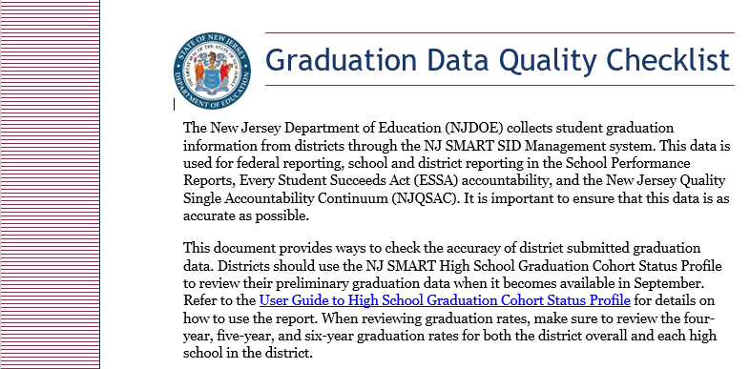
Graduation Appeals
The graduation appeals period, which runs from mid-September to early October, gives LEAs the chance to review and correct graduation data.
Graduation rates cannot be changed after the appeals deadline.
The NJDOE created a Graduation Data Quality Checklist to help LEAs review their graduation data during the preliminary review/appeals period starting in September.

Slide 34
Chronic Absenteeism in NJSMART

Slide 35
Definition/How It’s Calculated
Chronic absenteeism is defined as being absent for 10% or more of the days enrolled during the school year.
A student who is not present for any reason, whether excused, unexcused, or for disciplinary action, is considered absent unless permitted by state statute or regulations.
Equation = (Number of students with greater than or equal to 10% days absent)/ (Total number of actively enrolled students)

Slide 36
Chronic Absenteeism Accountability
Student absences provide important information about a school’s culture and climate. Research shows that absences impact a student's ability to succeed in school.
The NJDOE used input from various stakeholder groups throughout New Jersey to select chronic absenteeism to measure school quality and student success for the Every Student Succeeds Act (ESSA) accountability plan.
Students with fewer than 45 days in membership are excluded from attendance calculations.

Slide 37
Data Dashboards

Slide 38
What are data dashboards?
“Dashboards are a collection of widgets that give you an overview of the reports and metrics you care about most. Dashboards let you monitor many metrics at once, so you can quickly check the health of your accounts or see correlations between different reports. Dashboards are easy to create, customize and share.” ~ Google (link here)
“A dashboard is a visual representation of key metrics that allow you to quickly view and analyze your data in one place. Dashboards not only provide consolidated data views, but a self-service business intelligence opportunity, where users are able to filter the data to display just what’s important to them.” ~ Microsoft (link here)
“We use dashboards as one mechanism to address this challenge of staying on top of activity in our cloud services. Dashboards are the human-facing views into our systems that provide concise summaries of how the system is behaving by displaying time series metrics, logs, traces, and alarms data.”
~ Amazon (link here)

Slide 39
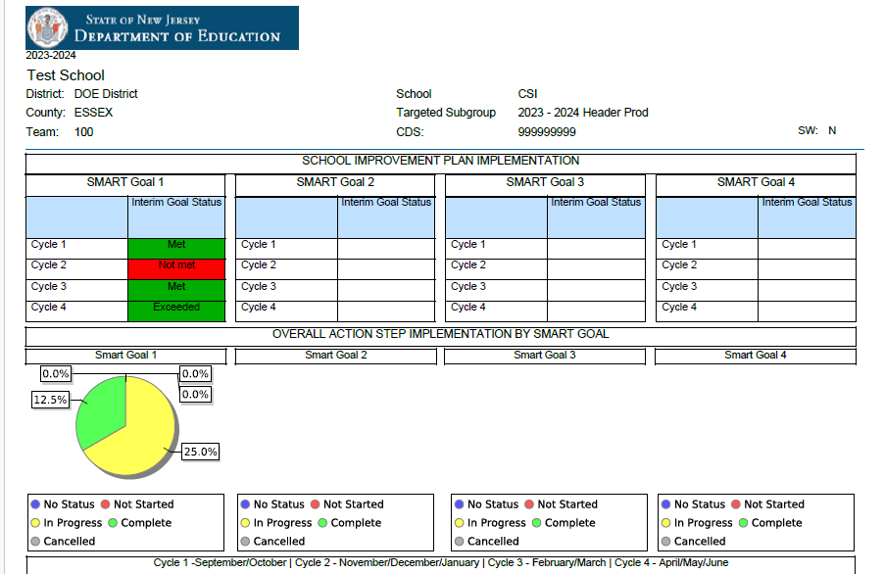
Annual School Planning System
Click
here

Slide 40
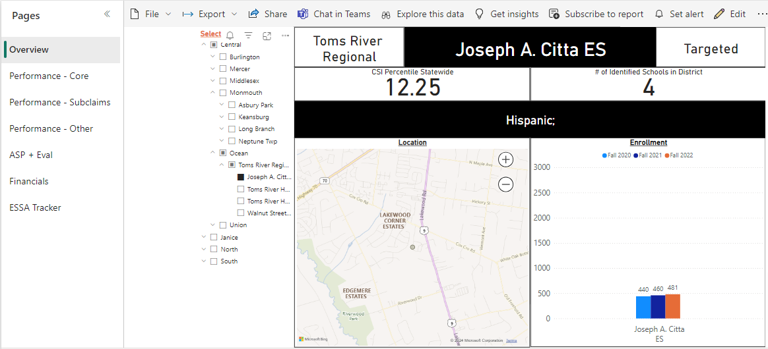
General Schools Dashboard
Click here

Slide 41
Chat Question
What five metrics do you need to look at every day in your role?
Examples:
Teacher attendance
Student attendance
Homework assignments submitted
Objective mastery
Detentions/disciplinary data

Slide 42
NJSLA Data Releases (Summer 2023)
Report | Assessment | Published | Content + Question
District Summative Record | NJSLA | 7.28.23 | Raw, district-wide student-level data: Did students who took longer on the assessment have higher performance?
District Summary Record | NJSLA | 8.8.23 | Raw, district-wide student group-level data: How did Black 5th grade students perform at School A in the district vs. at School B?
District Performance Level Summary | NJSLA | 8.11.23 | At-a-glance performance rates overall and disaggregated by student group: How did students with IEPs perform relative to the district as a whole?
District Summary of Schools | NJSLA | 8.11.23 | Performance by school by subclaim; What may have accounted for differences in performance in Modeling on the math NJSLA between students at School C and School D?
District Evidence Statement Analysis | NJSLA | 8.23.23 | Standard-level reports: What standards did students perform strongest/weakest on? How should we revise our curriculum map in light of this?
District Student Content Roster Data | NJSLA | 9.8.23 | Subclaim-level raw data: Are there any noticeable differences between student performance on particular subclaims?

Slide 44
Next Steps
Be on the lookout for NJSLA data releases this upcoming summer
Reach out to your field teams or liaison about Annual School Plan development support
Access the PowerPoint presentations from each of the four prior data literacy trainings within the ASPS (Under Professional Development Resources)
Be on the lookout for the 2024-25 schedule of data literacy trainings as well
Please complete feedback survey (link in the chat).

Slide 45
Presenter Contact Information
Jennifer Hobbs Data Specialist, RST-North (973) 902-6969 jennifer.hobbs@doe.nj.gov
Reina Irizarry-Clark Data Specialist, RST-Central (609) 658-0366 reina.irizarry-clark@doe.nj.gov
Lindsay Wilhelmi-Guay Data Specialist, RST-South (856) 301-0087
lindsay.wilhelmi-guay@doe.nj.gov
Dr. Chimaobi Amutah Statewide Data Manager State Transformation Specialist (609) 468-7349 chimaobi.amutah@doe.nj.gov
Matthew Norcross Data Analyst (856) 372-0238 matthew.norcross@doe.nj.gov

Slide 46
Thank You!
New Jersey Department of Education: nj.gov/education
Office of Comprehensive Support: OCS@doe.nj.gov
ASP Technical Support: ASP@doe.nj.gov
Follow Us!
Facebook: @njdeptofed
Twitter: @NewJerseyDOE
Instagram: @NewJerseyDoe

